Slide 1
Chapter 08

Slide 2
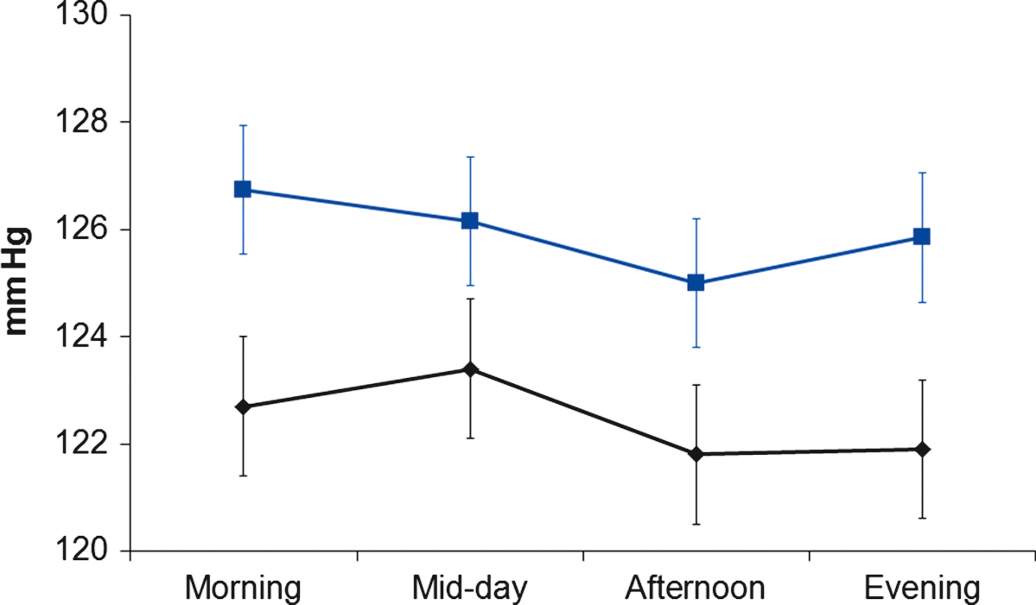
Figure 1 Mean systolic blood pressure in the morning, mid-day, afternoon, and evening periods in high (black line) and low (blue line) job control groups, adjusted for gender, employment grade, age, body mass index, smoking status, and physical activity. Error bars are standard errors of the mean (s.e.m.).
From Steptoe and Willemsen.¹¹

Slide 3
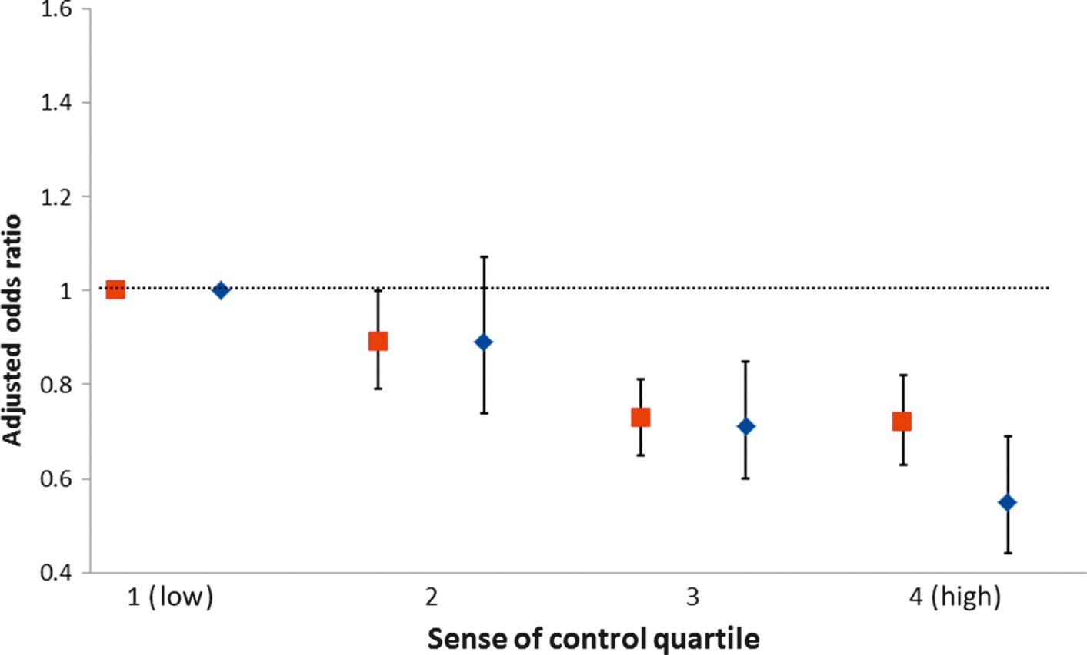
Figure 2 Adjusted odds of being an acute myocardial infarction case rather than control in four quartiles of sense of control in men (red) and women (blue). Data are adjusted for age, geographic region, and smoking. The lowest sense of control quartile is the reference group, and values below 1 indicate a protective effect. Error bars are 95% confidence intervals. From the INTERHEART study.
From Rosengren et al.²⁴

